Slide 1

SAP BTP ABAP on Cloud / RAP Training
DAY-16
Anubhav Oberoy
www.AnubhavTrainings.com
Follow excellence with sheer passion

Slide 2


DISCLAIMER
The training content and delivery of this presentation is confidential, and cannot be recorded, or copied and distributed to any third party, without the written consent of Anubhav Trainings

Slide 3

01
Custom Entity
Service consumption model
02
03
Access External API
04
Consume API
Notes:
https://pixabay.com/photos/san-francisco-transamerica-pyramid-1633203/

Slide 4
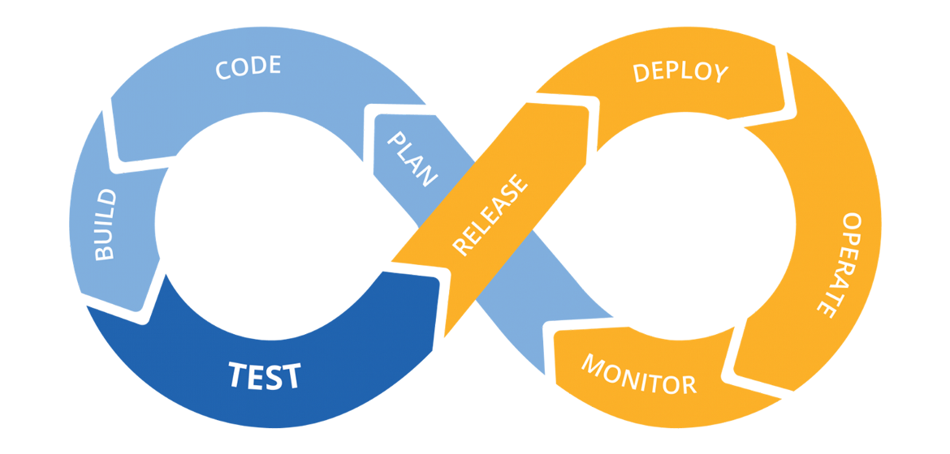
Hands on: Continuous Integration

Slide 5
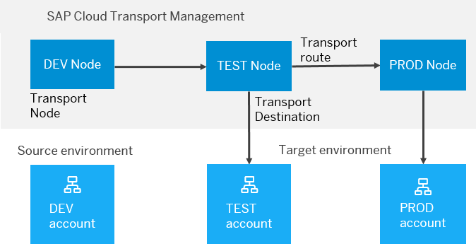
BTP Cloud Transport Management
SAP Cloud Transport Management service lets you manage software deliverables between accounts of different environments (such as Neo and Cloud Foundry), by transporting them across various runtimes. This includes application artifacts as well as their respective application-specific content.
SAP Cloud Transport Management service adds transparency to the audit trail of changes so that you get information about who performed which changes in your production environment, and when they did it. At the same time, the service enables a separation of concerns: For example, a developer of an application or of SAP Cloud content artifacts can trigger the transport of changes in a development subaccount, while the resulting import into the test, and production subaccount is handled by a central operations team.

Slide 6
Steps to implement the approver scenario
Go to base behavior definition and add non factory actions, provide implementation for the same
Create copy from processor cds entity projections and make new cds entities for projection for approver. Both travel and booking, ignore the booking supplement as a approver will only allowed to view upto the booking data.
Create metadata extensions for approver. Since approver can only see the data of travel and booking, we only created 2 MDE. Keep all the relevant fields and integrate code to show accept and reject travel buttons.
Now we provide behavior definition projection for approver which controls what an approver can do. As we know an approver can only edit bookingfee and travel status, he/she not allowed to create/update/delete any of the entities.
Customize our BDEF according to the needs of our user scenario.
Create a service definition for approver and service binding for approver.
Testing ☺
www.anubhavtrainings.com

Slide 7
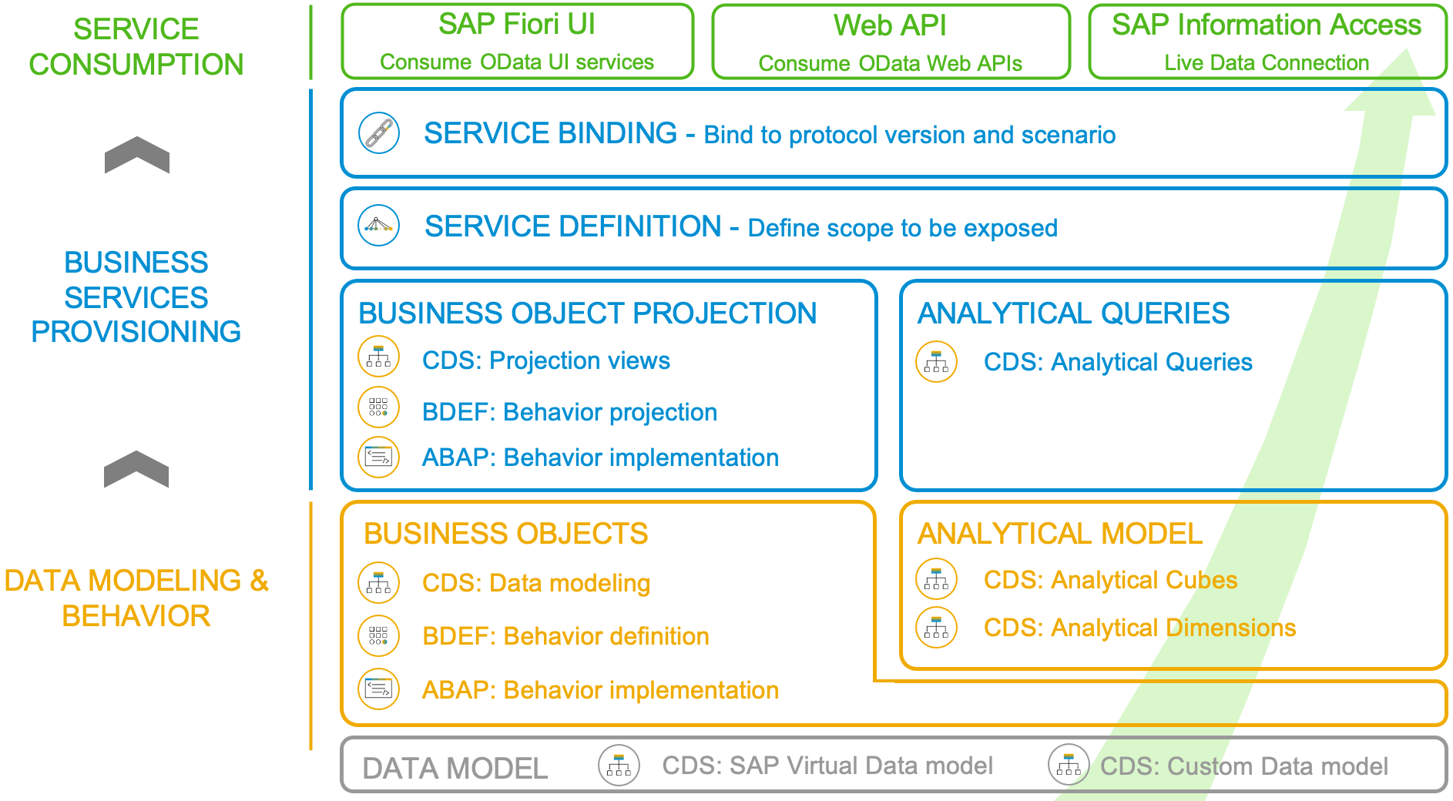
Development Flow of Scenario
With the 2102 release, the SAP BTP ABAP Environment opened up the door for analytics developments. The programming model follows the same “RAP” paradigm as in the transactional world: The entity model is implemented with CDS views that make use of additional analytical annotations that were now also released for the usage in the BTP ABAP Environment ("Steampunk”). As there is no access to the analytical backend transactions nor to the analytical key user tools, an analytical preview was also introduced, so that a developer can test his developments directly in the ABAP Development Tools. Another novelty is the introduction of an analytical service exposure. For an analytical service to be used as real time connection with a supported client (like e.g., SAP Analytics Cloud), the SAP Information Access protocol (InA) is required whereas transactional services rely on the OData protocol.
www.anubhavtrainings.com

Slide 8
ALP Analytic List Page
An Analytical List Page (ALP) is a SAP Fiori element that allows users to analyze data and take action on it. It's a key component of SAP Fiori embedded analytics.
Here are some things you can do with an ALP:
Analyze data: Use KPIs, charts, tables, and visual filters to analyze data from different perspectives
Investigate root causes: Drill down to find root causes
Act on transactional content: Take action on transactional content
Build apps: Create apps that visualize and report data
Combine data: Combine transactional and analytical data using charts and tables
ALPs have a flexible layout that can be customized in a number of ways, including:
Sorting: Sort the work list
Page layout: Set page layout preferences
Filters: Set filters and save filter selections
Default views: Set default views
ALPs are organized into two sections: a header section for setting filters, and a content section for displaying charts and lists.
www.anubhavtrainings.com

Slide 9
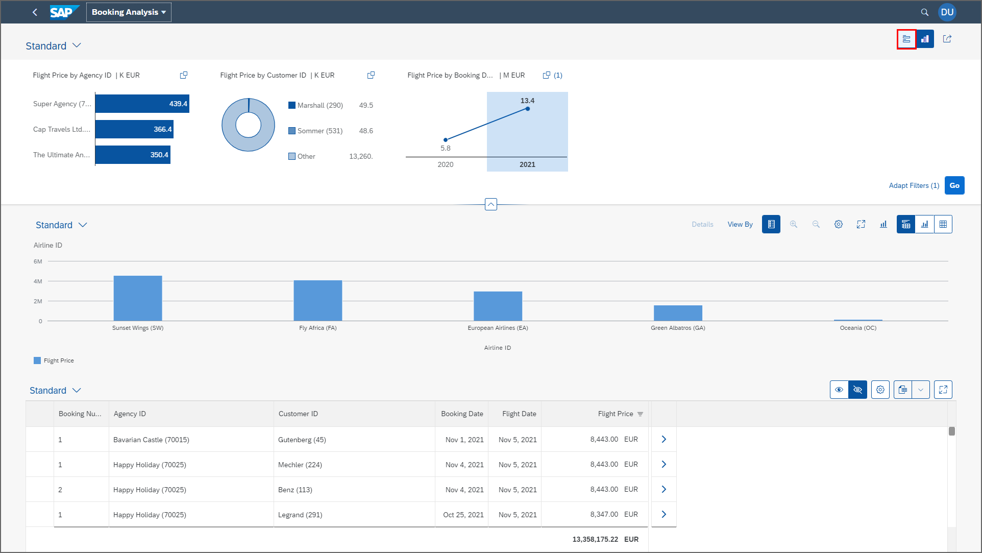
ALP
www.anubhavtrainings.com

Slide 10
Booking Consumption Analytics View
Booking Analytics CDS entity
Travel Analytics CDS entity
Carrier
Connection
/dmo/travel
/dmo/customer
/dmo/agency
Bookings

Slide 11
OVP – Overview pages
The Overview Page (OVP) in SAP is a data-driven app that provides users with a single page of information based on their role or domain. It helps users focus on important tasks by allowing them to quickly view, filter, and react to information.
Here are some things to know about the OVP:
Structure
The OVP has a header area and a content area. The content area displays cards that can contain charts, lists, tables, or text.
Cards
The OVP supports both standard and custom cards. Standard cards are entry-level views of the most relevant app data for a given topic or issue. Custom cards allow you to define the appearance and content of a card.
List cards
The OVP supports three types of list cards: list card, bar chart list card, and link list card.
Flavors
List cards can have two types of flavors: standard and bar. Standard flavor cards display items as numbers and text, while bar flavor cards display items as a combination of numbers, text, and a bar.
www.anubhavtrainings.com

Slide 12
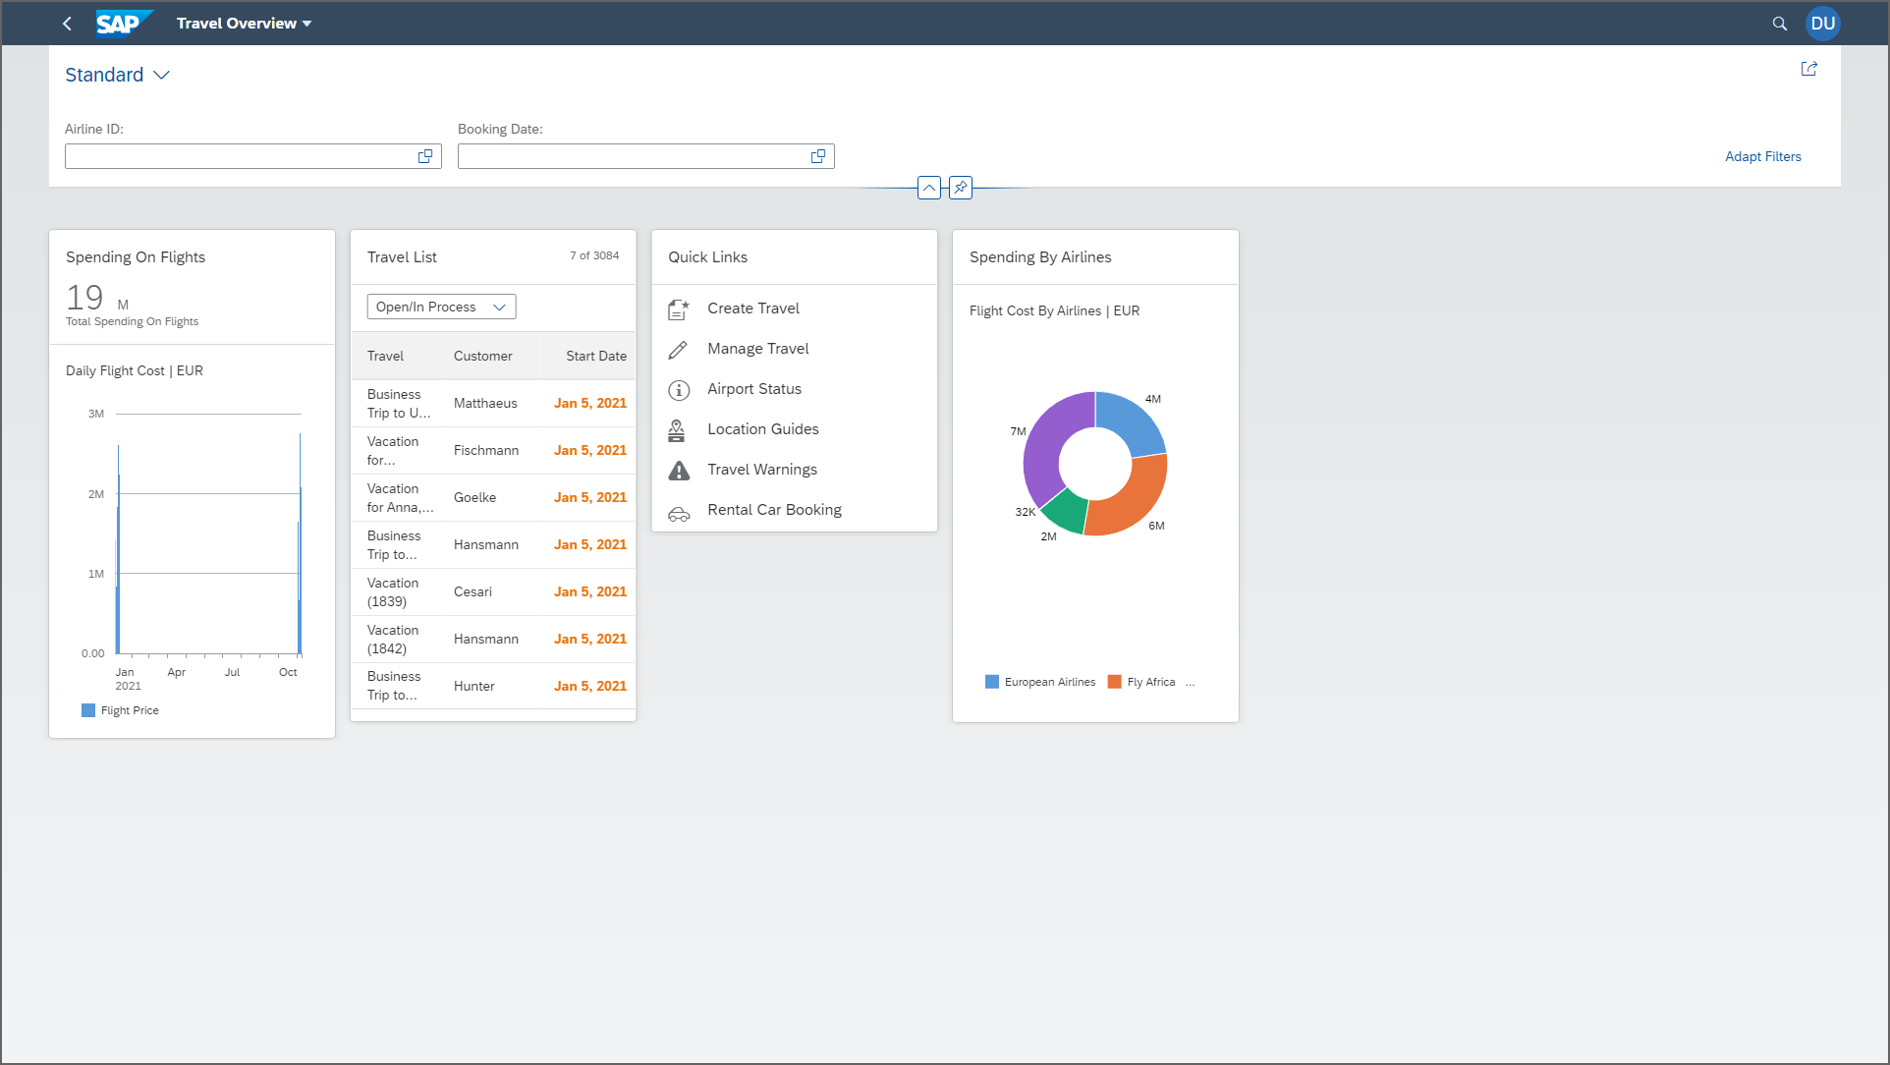
OVP
www.anubhavtrainings.com

Slide 13
Booking Consumption Analytics View
Booking Analytics CDS entity
Travel Analytics CDS entity
Carrier
Connection
/dmo/travel
/dmo/customer
/dmo/agency
Bookings

Slide 14
OVP – Overview pages
The Overview Page (OVP) in SAP is a data-driven app that provides users with a single page of information based on their role or domain. It helps users focus on important tasks by allowing them to quickly view, filter, and react to information.
Here are some things to know about the OVP:
Structure
The OVP has a header area and a content area. The content area displays cards that can contain charts, lists, tables, or text.
Cards
The OVP supports both standard and custom cards. Standard cards are entry-level views of the most relevant app data for a given topic or issue. Custom cards allow you to define the appearance and content of a card.
List cards
The OVP supports three types of list cards: list card, bar chart list card, and link list card.
Flavors
List cards can have two types of flavors: standard and bar. Standard flavor cards display items as numbers and text, while bar flavor cards display items as a combination of numbers, text, and a bar.
www.anubhavtrainings.com

Slide 15

OVP
www.anubhavtrainings.com

Slide 16
Reference Scenario – Unmanaged Impl.
Imagine in our company we had written all the business logic in the past ourself in form of FM, Classes. Today we want to reuse our old code which has the business logic, validation, sequence, processing, along with transaction buffer. So if you want to manage all these codes yourself and integrate your legacy (old code written by you or your team), you will opt for unmanaged (here RAP is not managing the CURD operation) scenario.
SAP is providing a demo class for learning purpose viz. /dmo/cl_flight_legacy
In this class we have our own old logic which contains the transaction buffer and business logic to maintain all the source code to interact with database ourself.
The RAP framework allows us to implement the entire runtime of the BO
Interaction Phase (code to interact and keep data inside itab)
Transaction Buffer (like a internal table where we keep temporary data)
Save Sequence (Commit work and Rollback)
UPDATE_BAPI
(LUW)
BAPI_TR_COMMIT
BAPI_TR_ROLLBACK
www.anubhavtrainings.com

Slide 17
Development Flow
Serv Impl.
BIMP-unmanaged
Serv definition
BDEF - unmanaged
Travel_U
Travel_U_MDE
Agency
Customer
agency
customer
/dmo/travel
www.anubhavtrainings.com

Slide 18
Title
<>
How you know in the code which fields are changed on the screen by the user.
So accordingly we can update the data into the database only for the changed fields??
RAP provides a compiler structure called %control which will tell us what fields were changed on UI.
We need to tell the RAP, what will be the datatype for the control structure.
*
*
*
www.anubhavtrainings.com

Slide 19
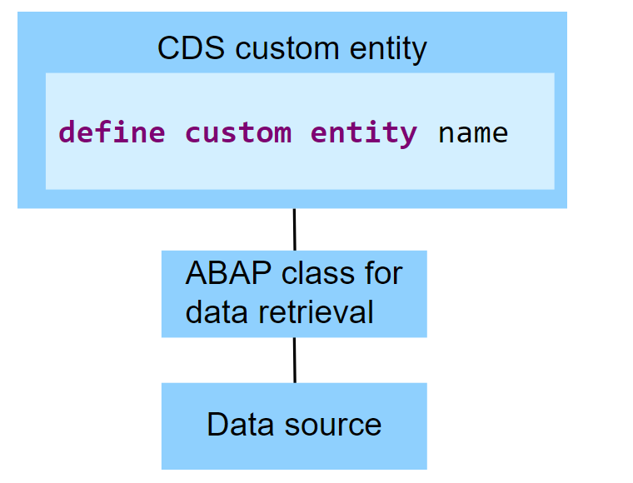
Custom Entities
A CDS custom entity allows developers to implement their own data retrieval using ABAP. A CDS custom entity is linked with an ABAP class and the data retrieval is executed on the application server. At the CDS level, only an interface is defined. Custom entities are used when data can't be accessed using SQL and the available CDS feature set.
The following image exemplifies the runtime of a CDS custom entity. It shows that the data retrieval is implemented by an ABAP class and the data source does not have to be a database table.
www.anubhavtrainings.com

Slide 20
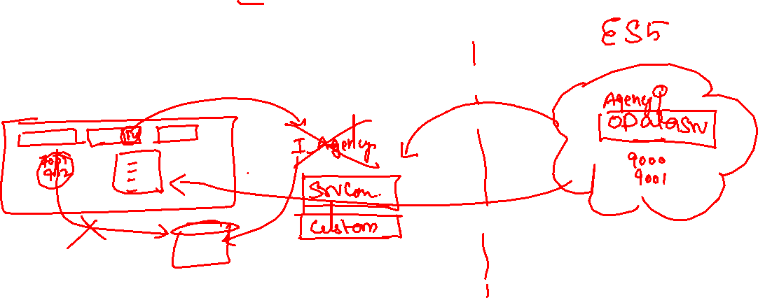
Reference Scenario – Custom Entity
In this exercise, we want to replace the travel agencies data of our managed travel app with the results of the remote OData service that provides different set of travel agencies from other system altogether. For this use case, we shall leverage the concept of a custom entity. In contrast to "normal" CDS views that read data from the database tables or other CDS views, the so-called custom entities act as a wrapper for a code-based implementation that provides the data instead. This use case involves following steps.
Creating the Service Consumption Model
Defining the Custom CDS Entity
Create a class that implements the query for the custom entity
Integrate the custom entity in MDE
www.anubhavtrainings.com

Slide 21










Slide 22
Reference Scenario – Unmanaged Impl.
Imagine in our company we had written all the business logic in the past ourself in form of FM, Classes. Today we want to reuse our old code which has the business logic, validation, sequence, processing, along with transaction buffer. So if you want to manage all these codes yourself and integrate your legacy (old code written by you or your team), you will opt for unmanaged (here RAP is not managing the CURD operation) scenario.
SAP is providing a demo class for learning purpose viz. /dmo/cl_flight_legacy
In this class we have our own old logic which contains the transaction buffer and business logic to maintain all the source code to interact with database ourself.
The RAP framework allows us to implement the entire runtime of the BO
Interaction Phase (code to interact and keep data inside itab)
Transaction Buffer (like a internal table where we keep temporary data)
Save Sequence (Commit work and Rollback)
UPDATE_BAPI
(LUW)
BAPI_TR_COMMIT
BAPI_TR_ROLLBACK
www.anubhavtrainings.com

Slide 23
Development Flow
Serv Impl.
BIMP-unmanaged
Serv definition
BDEF - unmanaged
Travel_U
Travel_U_MDE
Agency
Customer
agency
customer
/dmo/travel
www.anubhavtrainings.com

Slide 24
Title
<>
How you know in the code which fields are changed on the screen by the user.
So accordingly we can update the data into the database only for the changed fields??
RAP provides a compiler structure called %control which will tell us what fields were changed on UI.
We need to tell the RAP, what will be the datatype for the control structure.
*
*
*
www.anubhavtrainings.com

Slide 25
www.anubhavtrainings.com
Thank You
End of Day 14
www.anubhavtrainings.com

Slide 26


We’re committed to empower you to be
#FutureReady
through powerful training solutions.
We build the workforce of the future.
250+
Corporate Clients
30,000+
Learners Trained
25000+
Learners Placed
FREE WEBINARS
Sign up for free webinars with industry experts every fortnight!
Enroll Now!
Contact us today!
https://anubhavtrainings.com

